Slide 1
SEC555
Presentation based on SEC555: SIEM with Tactical Analytics
MITRE ATT&CK and Sigma Alerting
Justin Henderson (GSE # 108) and John Hubbard
@SecurityMapper @sechubb

Slide 2


About Us
Justin Henderson
SEC555 Author / SEC455 and SEC530 Co-Author
GSE #108 / Cyber Guardian Blue + Red / 60 certs
Owner of H & A Security Solutions
Twitter: @SecurityMapper
John Hubbard
SEC555 / SEC511 Instructor
SEC450 Author / SEC455 Co-author
SOC Lead, GMON | GREM | GPEN
Twitter: @SecHubb

Slide 3
Welcome!
A copy of this talk is available at: https://github.com/HASecuritySolutions/presentations
More free stuff: https://github.com/HASecuritySolutions

Slide 4

MITRE ATT&CK
Adversarial Tactics, Techniques, and Common Knowledge
Focus is on actionable detection techniques
Given common adversarial methodologies
Framework is high-level enough to report on and adapt
Yet specific enough to provide actual items to look for

Slide 5
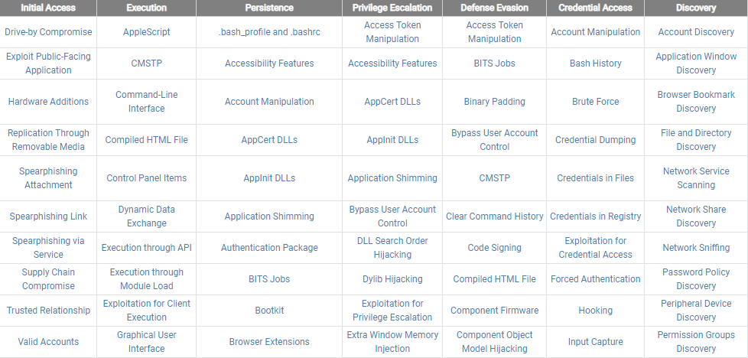
MITRE ATT&CK Matrix

Slide 6
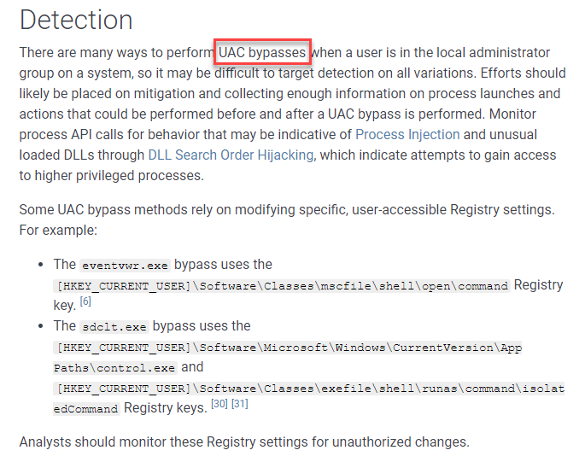
MITRE ATT&CK Matrix

Slide 7
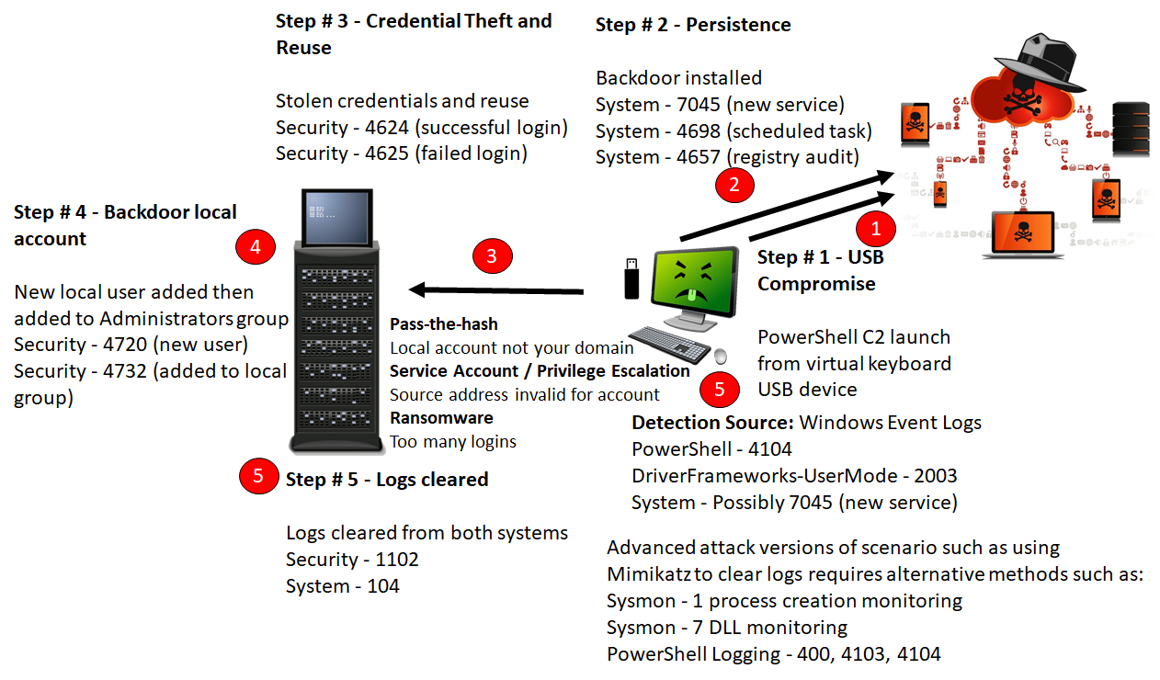
Change of Detection

Slide 8
Ways to ATT&CK
Security Incident and Event Management (SIEM)
Log agents
Windows Event Forwarding
Agentless
osquery
PowerShell
Python
Endpoint Detection and Response

Slide 9
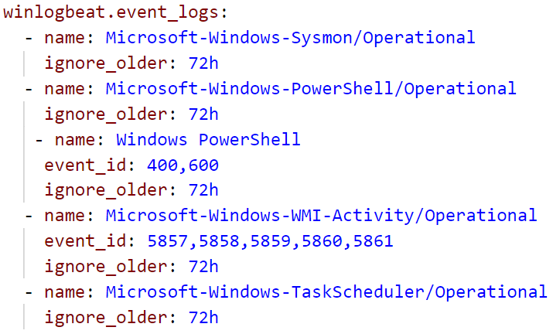

Log Agent Example
Full example at sec555.com/winlogbeat

Slide 10
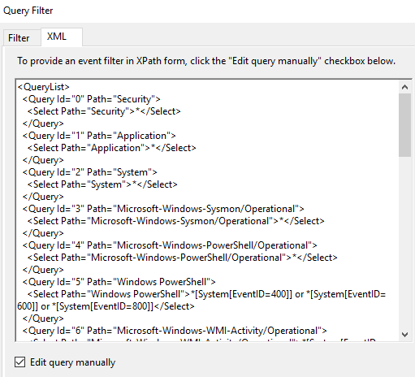
Windows Event Collector Example
Built-in "agents" are solid
Linux
Syslog-ng
rsyslog
Windows
Windows Event Forwarding
Windows Event Collector
Full example at sec555.com/wec

Slide 11
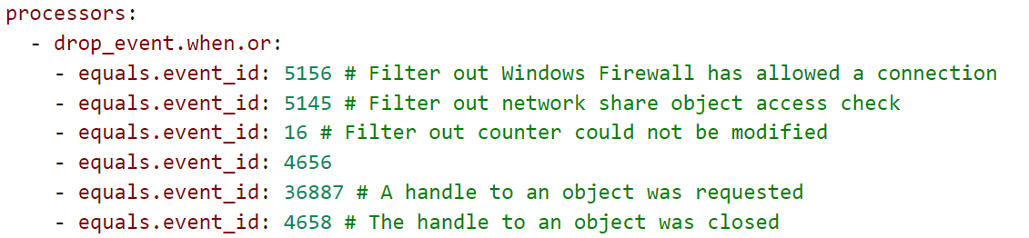
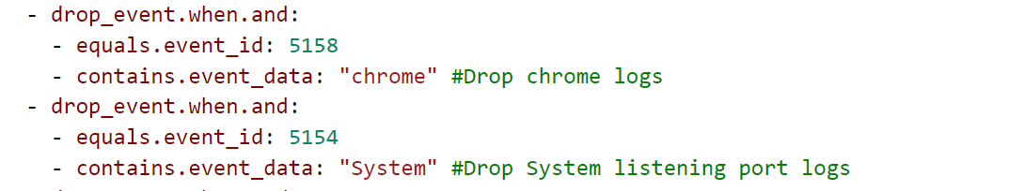
Do Not Collect/Retain Everything!

Slide 12
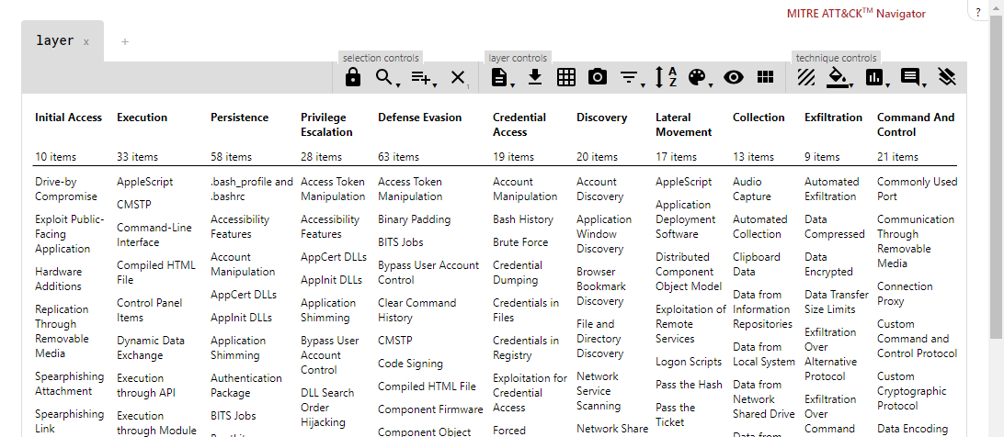
MITRE ATT&CK Navigator

Slide 13
Gap Assessment
Ongoing struggle to assess organization capabilities
With MITRE it is still difficult but much better
Below projects provide methods of self-assessment
Unfetter - Identifies gaps against ATT&CK
Atomic Red - Automated adversary simulation/assessment
Caldera - An automated adversary emulation system
Cascade - Helps apply automated hunting with modeling
TALR - Threat Alert Logic Repository (sharing is caring)

Slide 14
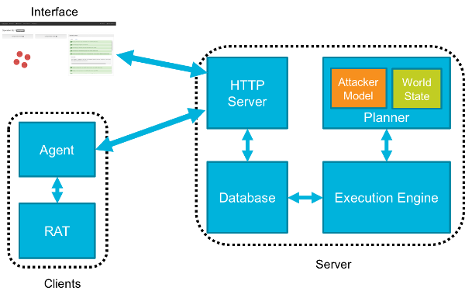
Caldera
Adversary emulation provides ongoing gap assessments
Not detected
Improve detection
Detected?
Learn what happened

Slide 15








Log Analysis
Enterprise log collection + SIEM
Detection:
Manual log analysis and hunting
…proprietary format SIEM Analytics ☹

Slide 16
Log Signatures?
Why is it so difficult?
Even in deployments of same SIEM…
Field names differ
Data sources differ
We collect in different log formats:
Windows logs – Syslog, JSON, XML
We have no common language to specify analytics

Slide 17
What Would It Take?
SIEM Alert Engine
Source_IP
SIEM Field Normalization
SrcIP
source_ip
src.ip
Generic:
"Match if Source IP = 1.2.3.4"
SIEM Pseudo-Analytic:
if (source_ip) == 1.2.3.4 {
Alert();
}
Identical Field Normalization
(Product and Environment Specific)

Slide 18

Sigma to the Rescue!
Written by Florian Roth & Thomas Patzke
"To logs, what Snort is to network traffic and YARA is to files"
High level generic language for analytics
Best method so far of solving logging signature problem!
Enables analytics re-use and sharing across orgs
MISP compatible - share and store aligned with threat intel
Decouples rule logic from SIEM vendor and field names
Eliminates SIEM tribal knowledge
Blue teams needs this!!!

Slide 19
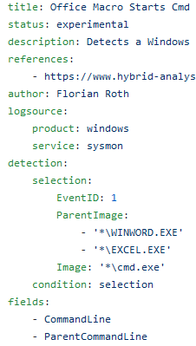
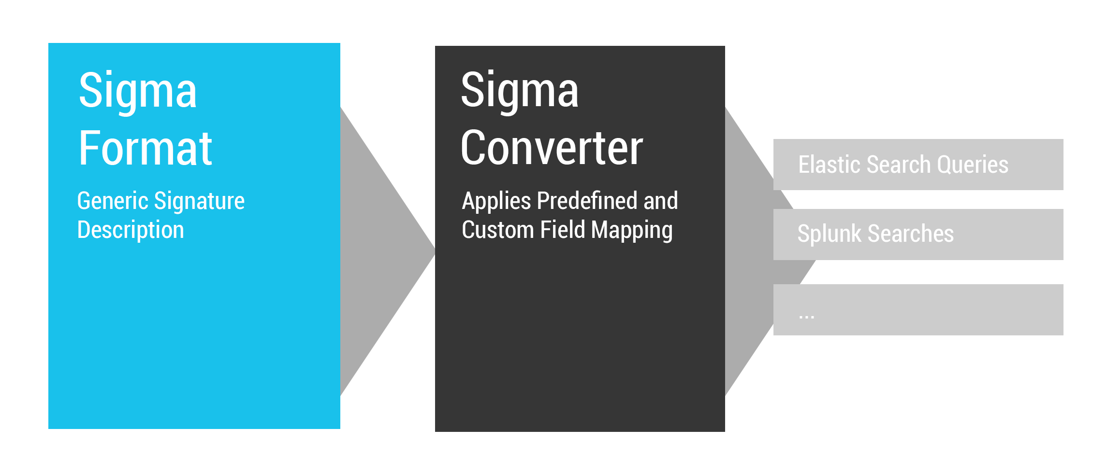
How Sigma Works

Slide 20
Conversion of Signatures to Alert Queries
Sigma Rule
Splunk
Company 1 field names
Company 2 field names
Qradar
Grep command
Elasticsearch
…
Grep
Search Query
Search Query
Company 3 field names
Search Query
…
Alert Engine
Alert Engine
Analytics
Alert Engine
Written by community
Mapping to your field names, written by you

Slide 21
Rule Format
Plain text YAML files
Easy schema
Metadata
Title, status, description, references, tags, etc.
Log Source
What type, brand, and service is the log from?
Detection – List of Selectors
Condition – Logic for selector matching

Slide 22
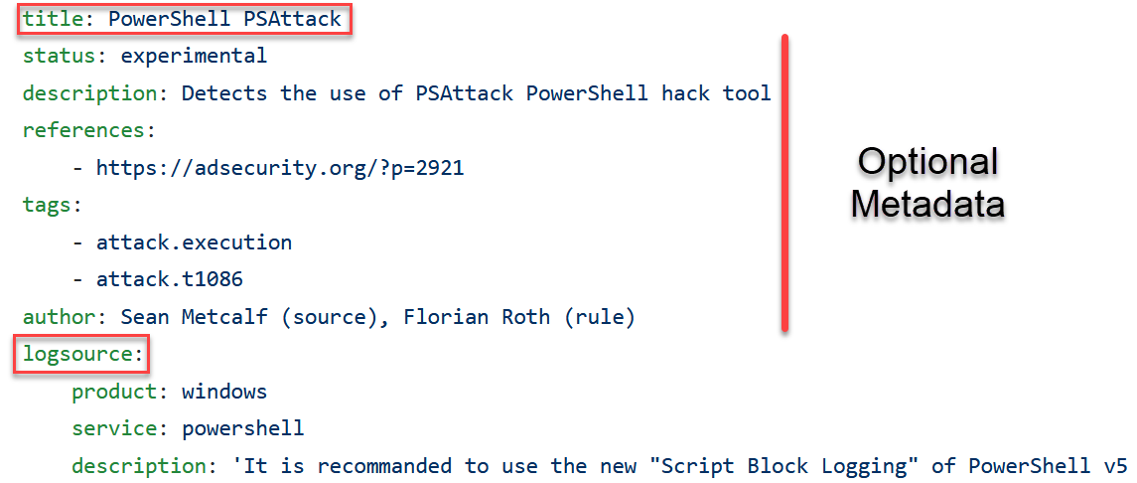
Title, Metadata, and Log Source

Slide 23
Log Source Section
Optional Classifiers:
category: proxy, firewall, AV, IDS
For all logs of a group of products
product: Squid, pfSense, Symantec, Snort, Windows
For all log outputs of one product
service: SSH, DNS, DHCP
For a subset of a products logs – sshd, named, …
description: Additional detail on log source, configs

Slide 24
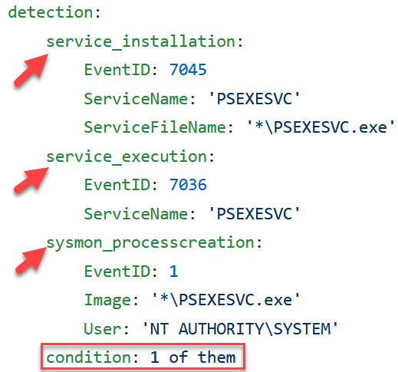
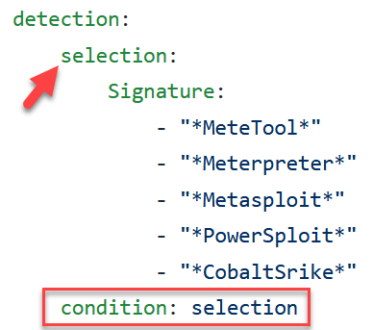
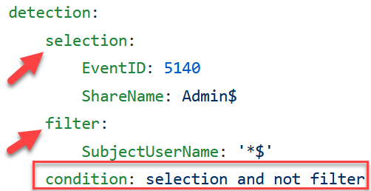
Detection & Conditions
Condition: Logic for rule matching
Detection: Object containing items of interest
[field name] - referenced in the condition
Examples:

Slide 25
Example Rule
$ cat inbound_ssh.yml
title: Inbound SSH login attempt
description: Alert when someone is trying to connect via SSH
author: John Hubbard
status: experimental
logsource:
category: firewall
product: ufw
detection:
selection_1:
destination_port: 22
destination_ip: 192.168.42.139
condition: selection_1
Log Sample:
Nov 20 13:23:51 ubuntu kernel: [219663.525528] [UFW AUDIT] IN= OUT=ens33 SRC=192.168.42.140 DST=192.168.42.139 LEN=60 TOS=0x00 PREC=0x00 TTL=64 ID=41584 DF PROTO=TCP SPT=52900 DPT=22 WINDOW=29200 RES=0x00 SYN URGP=0
Nov 20 13:23:52 ubuntu kernel: [219664.531357] [UFW AUDIT] IN= OUT=ens33 SRC=192.168.42.140 DST=192.168.42.139 LEN=60 TOS=0x00 PREC=0x00 TTL=64 ID=41585 DF PROTO=TCP SPT=52900 DPT=22 WINDOW=29200 RES=0x00 SYN URGP=0

Slide 26
Splunk Rule Conversion
Field Mapping:
$ cat inbound_ssh.yml
title: Inbound SSH login attempt
logsource:
category: firewall
product: ufw
detection:
selection_1:
destination_port: 22
destination_ip: 192.168.42.139
condition: selection_1
$ cat splunk-sigmaui.yml
logsources:
ufw:
category: firewall
product: ufw
index: main
fieldmappings:
destination_port: destination_port
destination_ip: destination_ip
defaultindex: main
Rule Conversion:
$ ./sigmac --target splunk --config splunk-sigmaui.yml inbound_ssh.yaml
(index="main" destination_port="22" destination_ip="192.168.42.139")

Slide 27
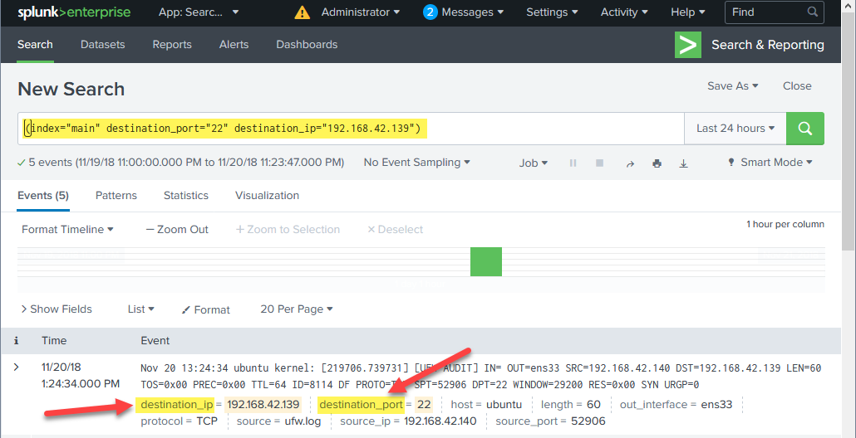
Splunk Results

Slide 28
Elasticsearch Rule Conversion
Field Mapping:
$ cat inbound_ssh.yml
title: Inbound SSH login attempt
logsource:
category: firewall
product: ufw
detection:
selection_1:
destination_port: 22
destination_ip: 192.168.42.139
condition: selection_1
$ cat elk-sigmaui.yml
logsources:
ufw:
category: firewall
product: ufw
index: firewall-ufw
fieldmappings:
destination_port: DPT
destination_ip: DST
defaultindex: firewall-ufw
Rule Conversion:
$ ./sigmac --target es-qs --config elk-sigmaui.yml inbound_ssh.yaml
(DPT:"22" AND DST:"192.168.42.139") //This would be run on the "firewall-ufw" index

Slide 29
What Was Just Done
One generic rule goes in…
Two formatted & customized search queries come out!
Sigma Rule (inbound_ssh.yml)
Splunk Format Converter
splunk_sigmaui.yml
Elasticsearch Format Converter
Search Query
elk_sigmaui.yml
Search Query
Analytics
Written by community
Customized for each deployment

Slide 30
Currently Supported Outputs
Splunk
QRadar
ArcSight
Elasticsearch (Elastalert, Query strings, DSL, Watcher, & Kibana)
Logpoint
Qualys
Windows Defender ATP
PowerShell
grep

Slide 31
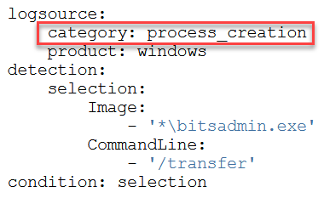
Coming Soon: Generic Log Sources
Many separate process creation event sources:
Security Event 4688
Sysmon Event 1
Defender ATP
OSQuery
EDR suites…etc.
Mapping is difficult for each unique event ID / field name
Solution: Generic Log sources

